Slide 1


Recovery of Sugars from Waste Soft Drinks
BY ABDUL AHAD KHAN
BENGALURU

Slide 2
INTRODUCTION
ECONOMICAL & ENIVIRONMENTAL ASPECTS:
Global sales of soft drinks are about $350 billion per year which is over 257 billion litres. Of this a significant portion of it goes unconsumed and is discharged as effluent.
Example: The Coca-Cola Company, one of the leading manufacturers in the world produced 2.4 billon cans last year, of which only 1.8 billon cans were sold and consumed.
Most soft drink companies dispose of wastes in limited quantities through the process of adjusting the pH of the soda waste to meet regulations of the neighboring water treatment plant. These soft drink plants are thus paying to have their waste taken away. [1]

Slide 3
INTRODUCTION
At Hindustan Coca Cola Beverages 20.1 Million INR was spent to treat 1200 m³/day of effluent from COD 3000 mg/l to COD – 100 mg/l.
Another soft drink plant at Nashik, India spent 4.9 Million INR to treat 400 m³/day of effluent with inlet COD 1500 mg/L to COD – 100 mg/L discharge.
Therefore, it is desired to have a cheaper and more environment friendly disposal method.

Slide 4
INTRODUCTION
The fruit juices, fruit drinks and carbonated beverages contain an average total amount of sugars (fructose + glucose + sucrose) of 9.3–9.8 %[1], which can be used for something useful.
Through literature survey it was found that physical adsorption is the most efficient and economical method to remove the sugar from the soft drinks.[4]

Slide 5
OUR AIM?
The primary aims of the project are-
To reduce the expired soft drink waste, generated as industrial waste.
To identify a suitable adsorbent to adsorb sugar form expired carbonated soft drinks.
Using the adsorbent as an alternate fuel.

Slide 6
AIM
These aims can be achieved by fulfilling the following objectives:
Reduce the water content of the soft drink by concentration.
Find the best adsorbent to extract sugar. List of provable sugar adsorbents[4]can be:
Sawdust
Rice husk
Coir
Their combination.

Slide 7
EXPERIMENTAL SETUP
Concentration to facilitate better adsorption, as adsorption increases with increase in adsorbate concentration.
Sieving of adsorbent.
Adsorption by mechanical shaking.
Pelletizing the different samples and determine the calorific value .

Slide 8
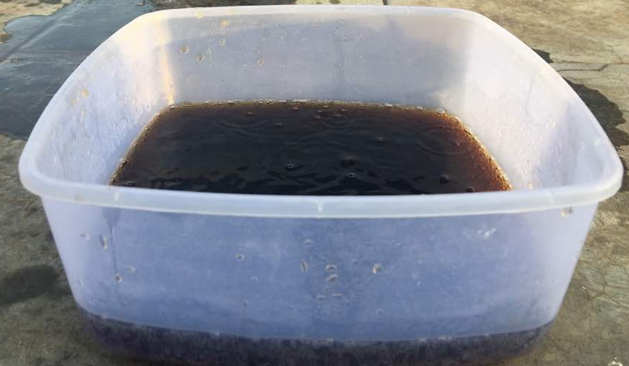
EXPERIMENTAL EXECUTION
CONCENTRATION:
2 liters of the expired carbonated soft drink was poured into vessel and was exposed to solar radiation.
The experiment is commenced from 9 am to 5 pm.
A denser liquid, reduced by about 48% is obtained over a period of 2 days which can be used for adsorption.

Slide 9
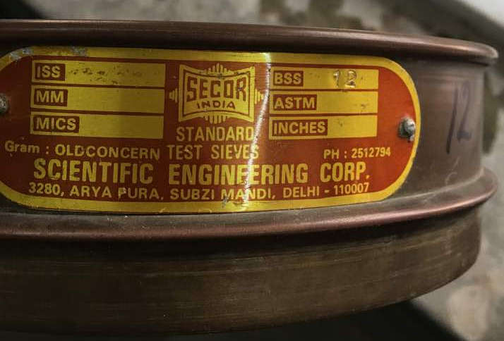
EXPERIMENTAL EXECUTION
SIEVING:
The saw dust, coir and rice husk obtained commercially contain uneven and large particles which are not suitable adsorbents.
To remove undesirable particles, these are passed through a sieve of BSS-12, 1.4 mm aperture width.

Slide 10
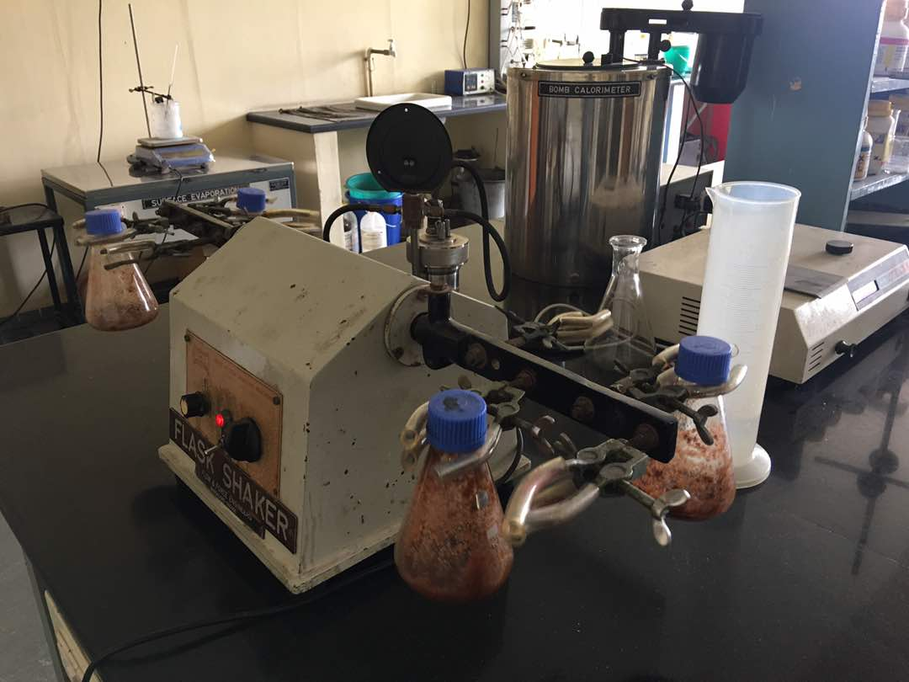
EXPERIMENTAL EXECUTION
ADSORPTION
A series of adsorption experiments were carried out at room temperature (25°C). All adsorption experiments were performed on a mechanical wrist action shaker at 120 rpm using 250 ml conical flasks.
The different proposed materials and their combinations were used for adsorption as mentioned below:
Majority of the samples are made from saw dust as they are very good adsorbents with large surface area.

Slide 11
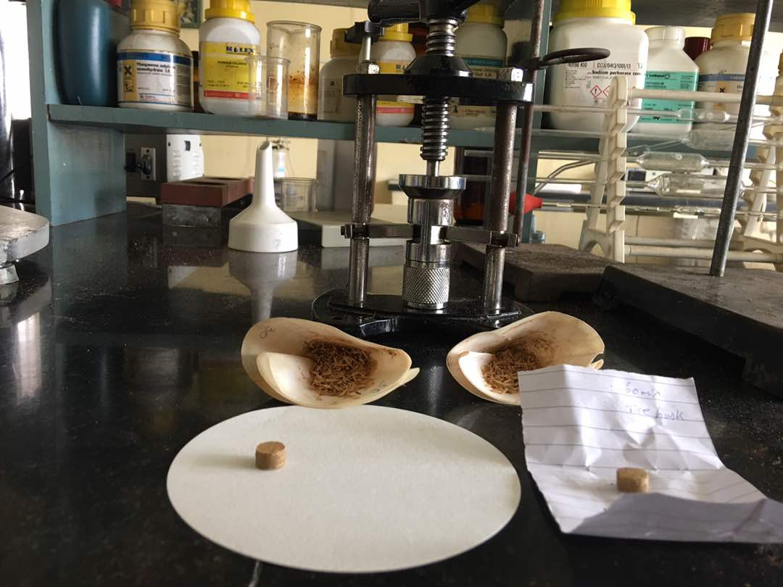
EXPERIMENTAL EXECUTION
PELLETIZING:
0.5g of each of the adsorbed sample is weighed and made
into small pellets using a screw type pelletizer.
The best adsorbent is determined and pelletized to form
briquettes.
Briquettes serve as an alternate fuel.

Slide 12
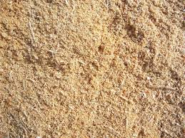
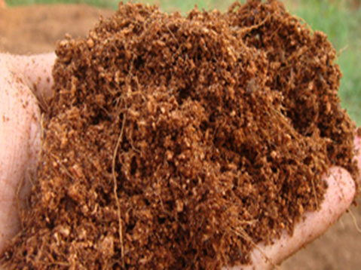
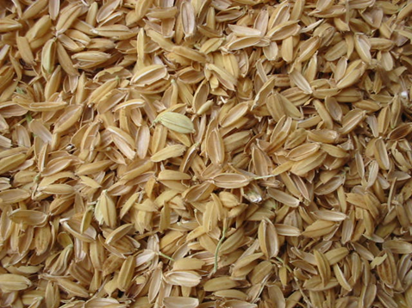
EXPERIMENTAL EXECUTION
The different proposed materials and their combinations were used for adsorption as mentioned below:
Sample 1:
150g of sawdust in 1000ml Pepsi
Sample 2:
1g of sawdust in 20ml Pepsi
Sample 3:
1g of activated sawdust in 20ml Pepsi
Sample 4:
2g of sawdust in 40ml Pepsi

Slide 13
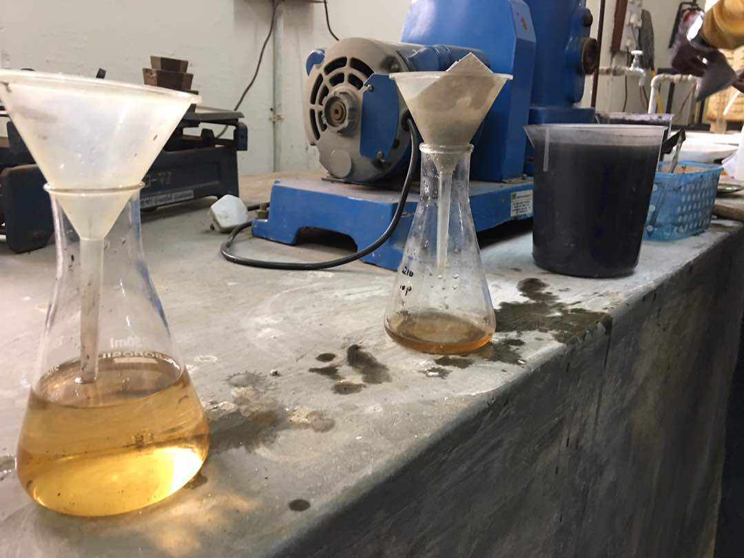
EXPERIMENTAL EXECUTION
Sample 5:
1g of rice husk in 20ml Pepsi
Sample 6:
1g of coir in 20ml Pepsi
Sample 7 (combination A):
0.5g of each of saw dust, coir and rice husk in 30ml Pepsi
Sample 8 (combination B):
1g of each of saw dust, coir and rice husk in 60ml Pepsi
Sample 9 (combination C):
3g of saw dust, 1g of rice husk and 2g of coir in the ratio of 3:1:2 in 120ml Pepsi.

Slide 14
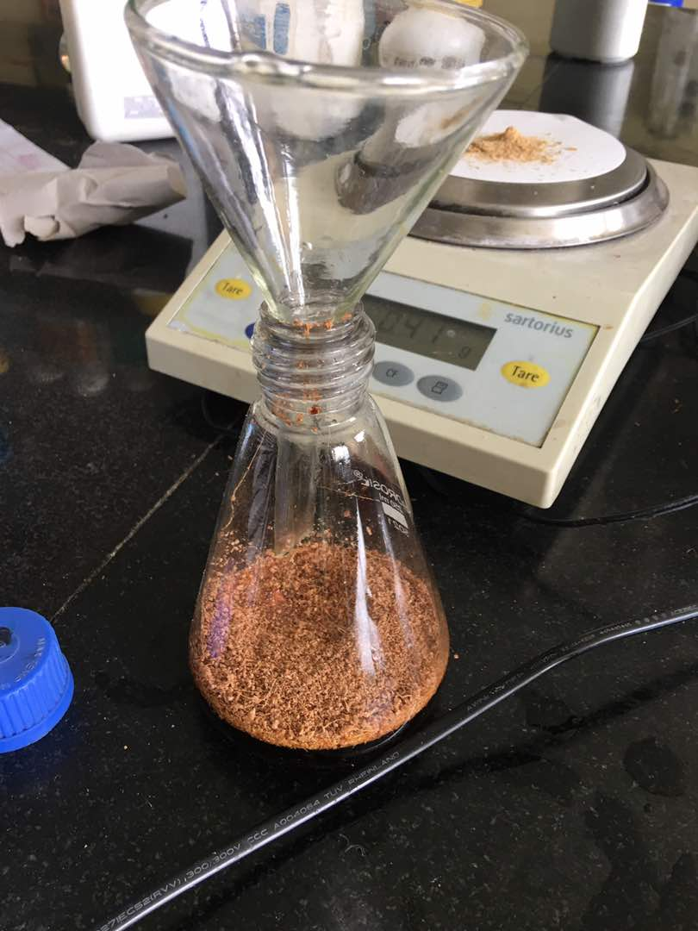
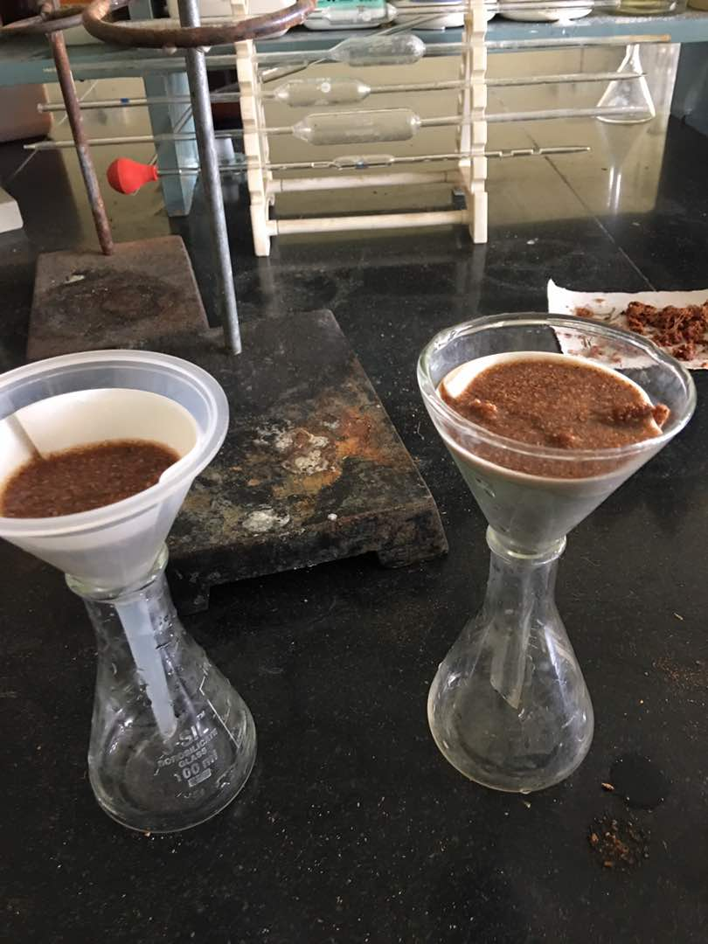
EXPERIMENTAL EXECUTION
Sample 10 (combination D):
2g of saw dust, 3g of rice husk and 1g of coir in the ratio of 2:3:1 in 120ml Pepsi.
Sample 11 (combination E):
2g of saw dust, 1g of rice husk and 3g of coir in the ratio of 2:1:3 in 120ml Pepsi.
Sample 12 (combination F):
3g of saw dust, 2g of rice husk and 1g of coir in the ratio of 3:2:1 in 120ml Pepsi.
Sample 13 (combination G):
1g of saw dust, 3g of rice husk and 2g of coir in the ratio of 1:3:2 in 120ml Pepsi.
Sample 14 (combination H):
1g of saw dust, 2g of rice husk and 3g of coir in the ratio of 1:2:3 in 120ml Pepsi.

Slide 15
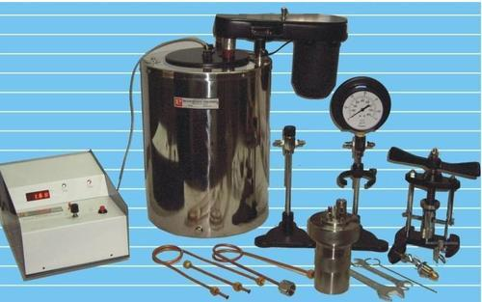
EXPERIMENTAL EXECUTION
CALORIFIC VALUE:
The adsorbed sample in each case is tested for its calorific value to note the increase in calorific value
Increase in calorific value is dur to adsorption of sugar.
Thus by using a bomb calorimeter the amount of sugar
adsorbed is indirectly determined.

Slide 16
RESULTS OBTAINED
SAMPLE 2 (1g sawdust)
SAMPLE 5 (1g rice husk)
Adsorption time (min) | Rise in temp (°C) | Gross Calorific Value(kJ/kg)
0 | 0.82 | 1025.738
15 | 0.87 | 1088.324
30 | 1.01 | 1263.59
45 | 1.06 | 1326.194
60 | 1.07 | 1338.716
90 | 1.08 | 1351.237
Adsorption time (min) | Rise in temp (°C) | Gross Calorific Value(kJ/kg)
0 | 0.71 | 887.9139
15 | 0.74 | 925.4458
30 | 0.79 | 988.0014
45 | 0.84 | 1050.56
60 | 0.90 | 1125.635
90 | 0.93 | 1163.174
SAMPLE 6 (1g coir)
SAMPLE 4 (2g sawdust)
Adsorption time (min) | Rise in temp (°C) | Gross Calorific Value(kJ/kg)
0 | 0.75 | 938.0404
15 | 0.79 | 988.0943
30 | 0.84 | 1050.665
45 | 0.92 | 1150.787
60 | 0.98 | 1225.885
90 | 1.00 | 1250.919
Adsorption time (min) | Rise in temp (°C) | Gross Calorific Value(kJ/kg)
0 | 0.84 | 1050.772
15 | 0.87 | 1088.324
30 | 1.04 | 1301.152
45 | 1.07 | 1338.716
60 | 1.07 | 1338.716
90 | 1.09 | 1363.759

Slide 17
RESULTS OBTAINED
SAMPLE 7 (.5g 1:1:1 In 30ml)
SAMPLE 8 (1g 1:1:1 in 60ml)
Adsorption time (min) | Rise in temp (°C) | Gross Calorific Value(kJ/kg)
0 | 0.69 | 862.9643
15 | 0.71 | 887.9891
30 | 0.77 | 963.0671
45 | 0.75 | 938.0404
60 | 0.82 | 1025.636
90 | 0.83 | 1038.151
Adsorption time (min) | Rise in temp (°C) | Gross Calorific Value(kJ/kg)
0 | 0.69 | 862.9643
15 | 0.75 | 938.0404
30 | 0.76 | 950.5537
45 | 0.75 | 938.0404
60 | 0.82 | 1025.636
90 | 0.80 | 1000.608
SAMPLE 9 (3:1:2g in 120ml)
SAMPLE 11 (2:1:3g in 120ml)
Adsorption time (min) | Rise in temp (°C) | Gross Calorific Value(kJ/kg)
0 | 0.78 | 973.49
15 | 0.82 | 1039.72
30 | 0.91 | 1146.61
45 | 0.98 | 1239.71
60 | 1.01 | 1265.52
90 | 1.03 | 1286.38
Adsorption time (min) | Rise in temp (°C) | Gross Calorific Value(kJ/kg)
0 | 0.77 | 978.89
15 | 0.81 | 1011.03
30 | 0.89 | 1111.15
45 | 0.95 | 1192.50
60 | 0.99 | 1286.74
90 | 1.01 | 1269.69

Slide 18
RESULTS OBTAINED
SAMPLE 10 (2:3:1g in 120ml)
SAMPLE 12 (3:2:1g in 120ml)
Adsorption time (min) | Rise in temp (°C) | Gross Calorific Value(kJ/kg)
0 | 0.75 | 942.21
15 | 0.79 | 990.18
30 | 0.87 | 1090.29
45 | 0.93 | 1159.13
60 | 0.97 | 1213.36
90 | 0.99 | 1240.48
Adsorption time (min) | Rise in temp (°C) | Gross Calorific Value(kJ/kg)
0 | 0.77 | 955.15
15 | 0.81 | 1017.29
30 | 0.90 | 1136.18
45 | 0.96 | 1245.24
60 | 0.99 | 1248.83
90 | 1.01 | 1291.71
SAMPLE 13 (1:3:2g in 120ml)
SAMPLE 14 (1:2:3g in 120ml)
Adsorption time (min) | Rise in temp (°C) | Gross Calorific Value(kJ/kg)
0 | 0.74 | 935.95
15 | 0.78 | 983.92
30 | 0.85 | 1065.26
45 | 0.91 | 1146.61
60 | 0.96 | 1211.28
90 | 0.99 | 1238.40
Adsorption time (min) | Rise in temp (°C) | Gross Calorific Value(kJ/kg)
0 | 0.74 | 927.61
15 | 0.77 | 973.49
30 | 0.84 | 1054.83
45 | 0.90 | 1189.92
60 | 0.95 | 1194.59
90 | 0.97 | 1223.79

Slide 19
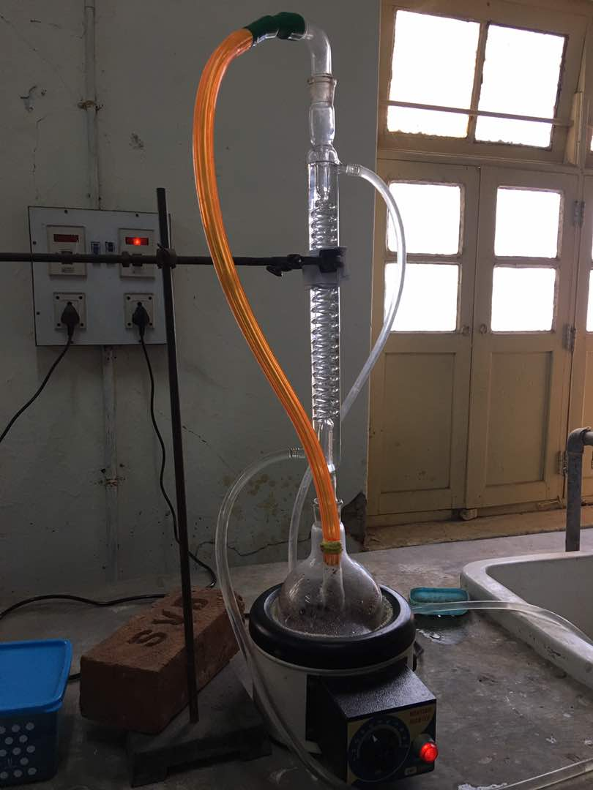
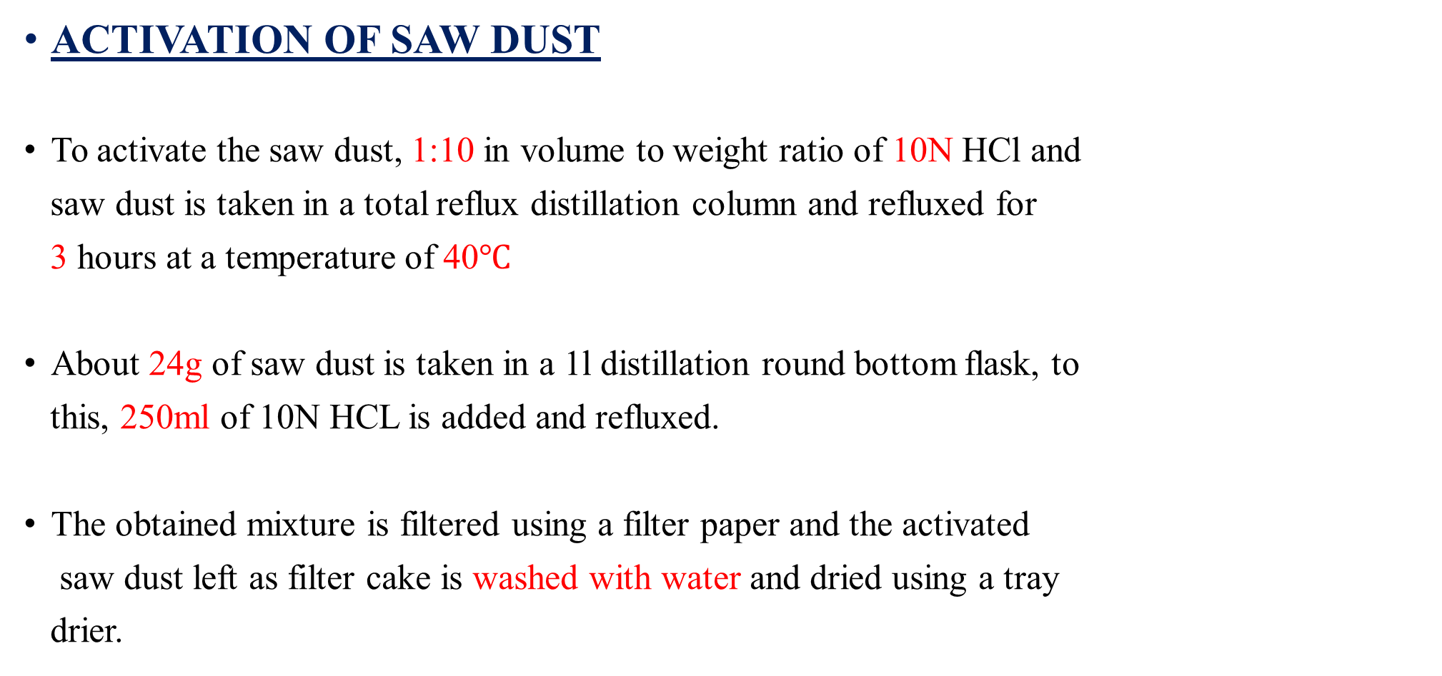
EXPERIMENTAL EXECUTION
ACTIVATION OF SAW DUST
To activate the saw dust, 1:10 in volume to weight ratio of 10N HCl and
saw dust is taken in a total reflux distillation column and refluxed for
3 hours at a temperature of 40$℃$
About 24g of saw dust is taken in a 1l distillation round bottom flask, to
this, 250ml of 10N HCL is added and refluxed.
The obtained mixture is filtered using a filter paper and the activated
saw dust left as filter cake is washed with water and dried using a tray
drier.

Slide 20
RESULTS OBTAINED
SAMPLE 3 (1g activated sawdust)
SAMPLE 2 (1g sawdust)
Adsorption time (min) | Rise in temp (°C) | Gross Calorific Value(kJ/kg)
0 | 1.00 | 1251.07
15 | 1.04 | 1301.152
30 | 1.12 | 1401.325
45 | 1.16 | 1451.417
60 | 1.20 | 1501.511
90 | 1.21 | 1514.035
Time | %increase
0 | 21.95
15 | 19.55
30 | 10.90
45 | 9.44
60 | 12.16
90 | 12.04
Adsorption time (min) | Rise in temp (°C) | Gross Calorific Value(kJ/kg)
0 | 0.82 | 1025.738
15 | 0.87 | 1088.324
30 | 1.01 | 1263.59
45 | 1.06 | 1326.194
60 | 1.07 | 1338.716
90 | 1.08 | 1351.237
Change in percentage calorific value with time for activated vs un-activated saw dust

Slide 21
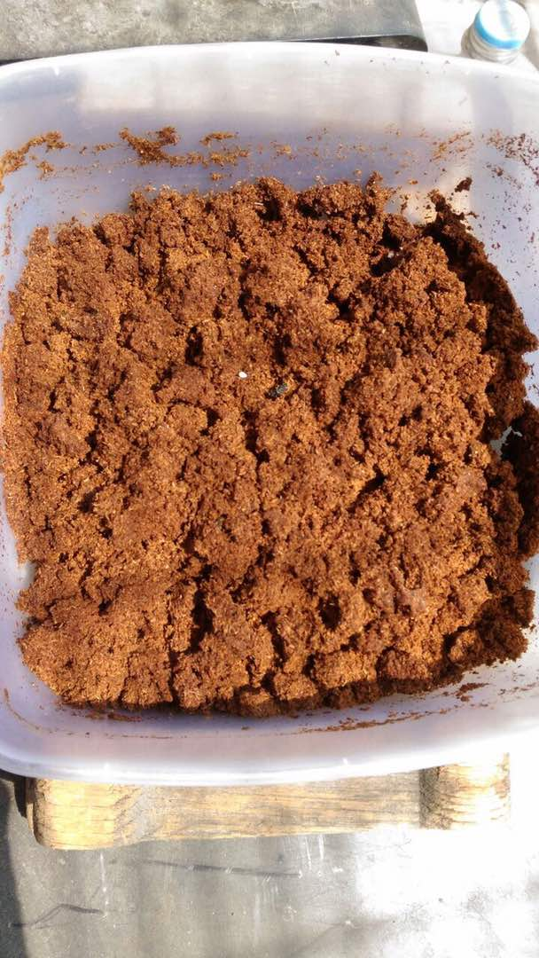
SUN DRYING OF MIXTURE
150 gm. of un-actived saw dust was taken in a container long with 1 litre of Pepsi drink and kept for drying for 2 days which consisted of 6AM to evening 6PM everyday.
The maximum and minimum temperature was 22 ˚C and 36 ˚C respectively with relative humidity of 30%.
The change in temperature was recorded in the bomb calorimeter and was 1.8 ˚C
The corresponding GCV was 22053.287 kJ/kg
The increase in weight of the sample after drying was recorded as 146 gm

Slide 22
COMPARISON OF GCV’S OF SAWDUST, RICE HUSK AND COIR
The order of absorbance is as follows from the graph
Saw dust
Coir
Rice husk

Slide 23
COMPARISON OF GCV'S OF ALL ADSORBENT SAMPLES
1gm activated saw dust shows elevated absorbance compared to all the adsorbent samples.
We thus conclude that saw dust which is activated gives the highest absorbance.

Slide 24
COMPARISON OF GCV’S OF DIFFERENT COMBINATIONS
From the above graph it is evident that the amount of sugar adsorbed is greatest in the combination which has the greatest proportion of saw dust thus concluding that saw dust has the greatest adsorption capacity of them all.

Slide 25
COMPARISON OF GCV’S OF SAWDUST AND ACTIVATED SAWDUST
From this graph, it is relevant that the activated sawdust adsorbs more sugar from the soft drink and therefore gives a higher GCV than regular sawdust.
Thus we can conclude that activation increases the adsorption capabilities of saw dust

Slide 26
CONCLUSION
The selected adsorbents may be viewed as a useful material while considering the economic aspects of soft drink effluent treatment.
The percentage of sugar removal is higher at the beginning. That is probably due to the larger surface area of the sawdust being available at beginning for adsorption.
Sawdust appears to be a promising adsorbent among all the selected adsorbents for removal of sugar from expired soft drinks.
The combination of saw dust, coir and rice husk showed no significant increase in adsorption of sugar.
Increase in the proportion of the saw dust in the combination however increased the amount of sugar adsorbed by the sample which further indicated that saw dust is the best adsorbent.

Slide 27
CONCLUSION
Increase in adsorbent dosage leads to increase in sugar adsorption due to increased number of adsorption sites. Maximum uptake of sugar was obtained at adsorbent dosage of 2g/10ml.
The activation of saw dust further resulted in the increase(almost twice of the un-activated saw dust) in adsorption. This was due to increase in the porosity of the adsorbent due to cleansing of the adsorption sites.
As sawdust has the highest calorific value among all the adsorbents used it can be used in making briquettes which serve as alternative fuel.

Slide 28
CONCLUSION
Sun drying of the sawdust and soft drink mixture was the best method to adsorb all the sugar from the soft drinks. Thus, we have found the best method of adsorption.
The raw materials are a largely wastes which are waste soft drinks and Argo and carpentry waste. Thus, this project solves the problem of environment pollution caused by disposal of waste and the pollution associated with burning nonrenewable sources of energy.
Therefore, the principle aims of utilizing waste and generating fuel out of it is achieved. Also, the problem of waste soft drink disposal is addressed.

Slide 29
REFERENCES
Birkhed, D. "Sugar content, acidity and effect on plaque pH of fruit juices, fruit drinks, carbonated beverages and sport drinks." Caries research 18.2 (1984): 120-127.
Raghuvanshi, Shiv Pratap, et al. "Removal of textile basic dye from aqueous solutions using sawdust as bio‐adsorbent." International journal of environmental studies 62.3 (2005): 329-339.
Shukla, Alka, et al. "The role of sawdust in the removal of unwanted materials from water." Journal of Hazardous Materials 95.1 (2002): 137-152.
Birkhed, D. "Sugar content, acidity and effect on plaque pH of fruit juices, fruit drinks, carbonated beverages and sport drinks." Caries research 18.2 (1984): 120-127.
Kini, Srinivas M., et al. "Adsorption of basic Dye from Aqueous Solution using HCl Treated Saw Dust (Lagerstroemia microcarpa): Kinetic, Modeling of Equilibrium, Thermodynamic, INDIA." International Research Journal of Environment Sciences 2.8 (2015).
Garg V.K., Gupta R., Yadav A.B. and Kumar R., Dye removal from aqueous solution by adsorption on treated sawdust, Bioresour. Technol., 89, 121–124 (2003)
Jain, Rajeev, Megha Mathur, and Shalini Sikarwar. "Removal of indigocarmine from industrial effluents using low cost adsorbent." Journal of Scientific and Industrial Research 65.3 (2006): 258.
Moreno-Castilla, Carlos. "Adsorption of organic molecules from aqueous solutions on carbon materials." Carbon 42.1 (2004): 83-94
Lyklema J. Fundamentals of interface and colloid science, Vol. II. solid–liquid interfaces. New York: Academic Press; 1995

Slide 30
REFERENCES
Ayranci, Erol, and Osman Duman. "Adsorption of aromatic organic acids onto high area activated carbon cloth in relation to wastewater purification." Journal of hazardous materials 136.3 (2006): 542-552.
Idah, P. A., and E. J. Mopah. "Comparative assessment of energy values of briquettes from some agricultural by-products with different binders." IOSR Journal of Engineering 3.1 (2013): 36-42.
Aina, O. M., A. Adetogun, and K. A. Iyiola. "Heat energy from value-added sawdust briquettes of albizia zygia." Ethiopian Journal of Environmental Studies and Management 2.1 (2009).
Kang, Aram, and Taek Soon Lee. "Converting Sugars to Biofuels: Ethanol and Beyond." Bioengineering 2.4 (2015): 184-203.
Ait Hsine, E., A. Benhammou, and M. N. Pons. "Water resources management in soft drink industry-water use and wastewater generation." Environmental technology 26.12 (2005): 1309-1316.
Haroon, H. A. J. I. R. A., Amir Waseem, and Qaisar Mahmood. "Treatment and reuse of wastewater from beverage industry." J Chem Soc Pak 35.1 (2013).

